Slide 1
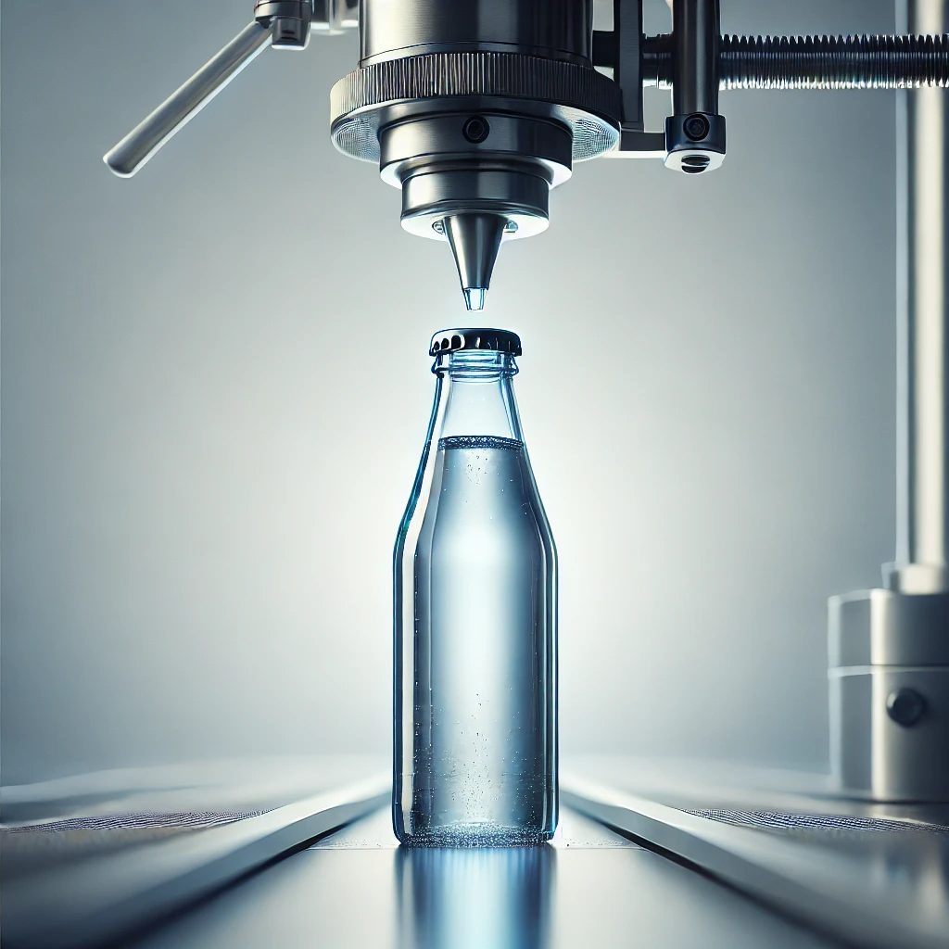
Title: Bottle Filling Simulation (D/D/1/K)
Presented By: Dipak Raj Giri
Semester: Seventh
University: Far Western University
Subject: Simulation and Modeling
Faculty:BE Computer

Slide 2


Overview of D/D/1/K Model
D: Deterministic interarrival and service times.
1: Single server system.
K: Finite queue capacity (Conveyor belt size).
01

Slide 3

Entities
Bottles (jobs to be processed).
Conveyor belt (queue).
Filling machine (server).
02

Slide 4

Parameters
Arrival Rate (λ)
Service Rate (μ)
Initial Bottles
Conveyor Belt Size (K)
03

Slide 5
Simulation Logic
Initial State
Arrival Logic
Serving Logic
End Conditions
04

Slide 6
Lets see the Simulation
05

Slide 7
Conclusion
Case 1: Server rate greater than arrival rate.
Case 2: Server rate equal to arrival rate.
Case 3: Server rate less than arrival rate.
06

Slide 8
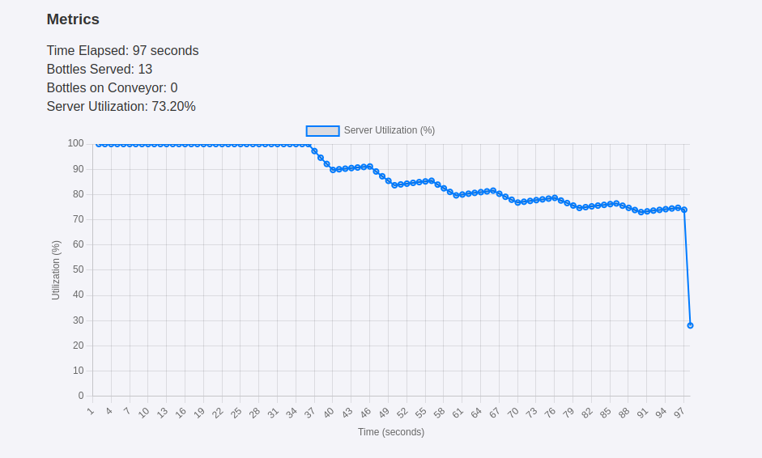
Server rate > arrival rate
07

Slide 9
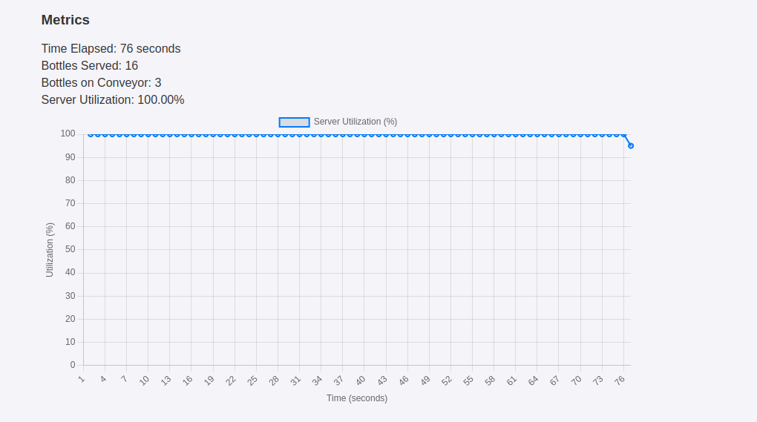
Server rate = arrival rate
08

Slide 10
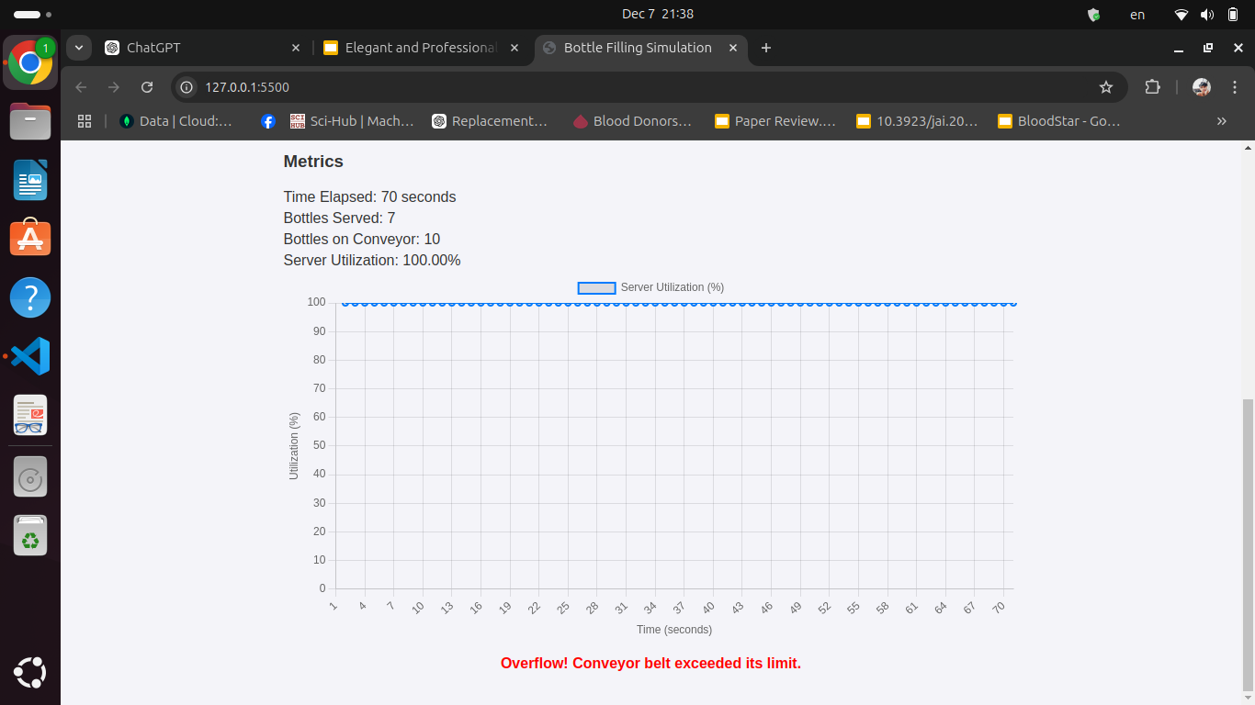
Server rate < arrival rate
09

Slide 11

OR
The Choice is Yours!!

